Slide 1


Wharton PLASTARC People Analytics Case Competition
Understanding Employee Workplace Preferences
Team - SFRR Analytics
Notes:
… evolving workplace preferences

Slide 2





SFRR Analytics Team Introduction
BUSINESS ANALYTICS AND DATA SCIENCE, MS
Frankle Muchahary
Roe Djer Tan
Data Science Intern
Statistical Analyst Intern
Ritwik Roy Chowdhury
Shreyan Datta Chakraborty
Analytics Consultant
Data Science Intern
Notes:
… Oklahoma state university

Slide 3



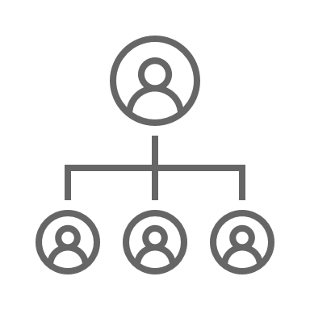


Executive Summary
Challenges
What are the factors driving employees’ productivity & workplace preferences?
How can an organization best support its employees ?
Varying Problems
Loss of productive hours due to layout & collab Issues
Collab effectively - key factor for determining work location
WFH Employees are uninterested in org. engagement
Recommendations
Designated focus areas
Foster “ownership culture”
Recognize merit
Gen AI workforce Copilot
+418 Productive hours (Per week for a 500 employee mid-sized org)
+1.6 points (Satisfaction Index)
Notes:
… productive hours and satisfaction index

Slide 4
Analysis on Productivity & Workplace Preference
Notes:
… our analysis

Slide 5



Collaborating effectively goes hand in hand with productivity
Colleague Access
Manager Interaction
Team
Meetings
Social Events
Client Engagement
1. Average of Perceived Ability to Focus, Create, and Innovate; 0 = Home Preferred, 5 = Office Preferred
2. Average of Perceived Ability for Colleague Access, Team Meetings Participation, Client Engagement, Social Events, and Manager Interaction; 0 = Home Preferred, 5 = Office Preferred
Notes:
… can be more productive in the office

Slide 6
Employees that prefer to work from home lost ~70 mins more on average due to office distractions pre-covid
+70 min
Lost less time at the office due to distractions pre-covid
Lost more time at the office due to distractions pre-covid
Layout Issues
Noise Disturbances
280
274
Time Loss Due to Distractions
(Minute/Week)
256
Visitor Disturbance
210
189
WFH Preference Rate
0-20%
20-40%
40-60%
60-80%
80-100%
Feel More Productive at Office ¹
Feel More Productive at Home ¹
1. Average of Perceived Ability to Focus, Create, and Innovate; 0 = Home Preferred, 5 = Office Preferred
Notes:
… prefer to work from home in the future

Slide 7

Employees that prefer working from home do not feel office involvement is important
WFH employees do not value office involvement/initiatives as much
More Important
3.1
3.1
3.0
3.0
Cultural Quotient ¹
2.9
2.9
Building Community Initiatives
Leadership Expectation
2.9
Cultural Quotient
2.8
2.7
Sense of Purpose, Belonging & Community
Social Events
2.6
2.5
2.5
0.0
0-20%
20-40%
40-60%
60-80%
80-100%
WFH Preference Rate
1. Average Importance of Factors (Sense of Purpose, Belonging, and Community; Social Events; Community Initiatives; Leaderships Expectation/Policy Guidance) Influencing Decision to WFH or at Office; 0 = Unimportant, 5 = Important
Notes:
Forbes acknowledges the challenge of enforcing office culture in a WFH (Work From Home) setting
Include “Importance in y axis”

Slide 8
Factor Analysis & Shapley Values corroborate our analysis about the key factors for determining work location preference
Data
Factor Name | Factor Alignment / Description | Shapley Values
Factor 9 – Work Location Preference | Preferred workplace and location for in-person collaboration and tasks that require undivided attention | 0.36
Factor 3 – Preferred Workplace Features | Importance of workplace and work environment features | 0.35
Factor 1 - Collaboration Satisfaction | Employee satisfaction levels with respect to collaboration in the existing workplace | 0.22
Factor 10 – Productivity Hindrances | Major workplace issues that contributed to loss of productive hours | 0.20
Preprocess Data For Modeling
Decompose
with Factor
Analysis
Decision
Tree
Model
Shapley Analysis
&
Analyze Factor
Loadings
Note: "Work Location Preference Composite Score” is used as Target Variable for Decision Tree Model Calculated as an Average of Perceived Optimal Work Environment for Supporting All Aspects ; 0 = Home Preferred, 5 = Office Preferred.

Slide 9
Understanding Diverse Workforce Preferences

Slide 10


Segmenting employees can help us understand their specific problems & needs
Productivity and Preference of Work Location
Home Anchors
39% Sales, Mktg, HR, Mgmt
33% Tech
Hybrid Force
25% Architecture & Construction
31% Tech
22% Sales, Mktg, HR, Mgmt
Office Cohort
33% Architecture & Construction
22% Environment & Transport
Prefer working from home 4+ days a week
Prefer working from home 2-3 days a week
Prefer working from home 0-1 day a week

Slide 11




Segment 1 – Noise and cultural disconnect in WFH employees requires attention
Productivity and Preference of Work Location
Home Anchors
39% Sales, Mktg, HR, Mgmt
33% Tech
Hybrid Force
25% Architecture & Construction
31% Tech
22% Sales, Mktg, HR, Mgmt
Office Cohort
33% Architecture & Construction
22% Environment & Transport
PROBLEM
PREFERENCE
SATISFACTION
105 min/week
Important (4/5)
Better at office (2.6/5)
Unsatisfied or Uninterested (3.5/5)
Noise Distraction
Highest time lost due to noise
Quiet &
Focused
Noise in the environment is very important for them (4.0)
Ability to concentrate is also important (3.6)
Perceived Collab Quotient Access to Managers, Clients, etc. Is better in office
But Perceived Productivity is better from home (1.3)
Organization Culture
Lowest Cultural Quotient (2.7)
Lowest organization culture satisfaction (3.5)

Slide 12



Segment 2 – Visitor Distractions cost hybrid employees more than 2 productive work hours
Productivity and Preference of Work Location
Home Anchors
39% Sales, Mktg, HR, Mgmt
33% Tech
Hybrid Force
25% Architecture & Construction
31% Tech
22% Sales, Mktg, HR, Mgmt
Office Cohort
33% Architecture & Construction
22% Environment & Transport
PROBLEM
PREFERENCE
SATISFACTION
137 min/week
Better at office (2.7/5)
Better at office (3.1/5)
Unsatisfied at home (2.2/5)
Visitors Disruption
Highest time lost due to visitors to office workstation
Productivity
Ability to innovate and be creative is better at office
Perceived Collab Quotient
Access to Managers, Clients, coworkers etc. is better in office
In-person Collab
In-person collab satisfaction is low from home (2.2)
In-person collab satisfaction is high from office (4.0)

Slide 13



Segment 3 – Opportunity in office design improvement for regular employees
Productivity and Preference of Work Location
Home Anchors
39% Sales, Mktg, HR, Mgmt
33% Tech
Hybrid Force
25% Architecture & Construction
31% Tech
22% Sales, Mktg, HR, Mgmt
Office Cohort
33% Architecture & Construction
22% Environment & Transport
PROBLEM
PREFERENCE
SATISFACTION
53 min/week
Important (3.9/5)
Better at office (3.6/5)
Needs Improvement (3.9/5)
Layout Distraction
Highest time lost due to layout navigational issues in workplace
Proximity to Co-workers
Being close to co-workers is an important factor for work
Perceived Collab Quotient
Access to Managers, Clients, coworkers etc. is better in office
Office Design
Not satisfactory for those frequent to the office

Slide 14
RECOMMENDATIONS

Slide 15



Designated focus areas & re-imagined workspace design can help enhance productivity in concentration-heavy tasks
Noise Distractions – More than 2 Productive Hours Lost ¹
Concentration Demanding Tasks – ~22% better performance in quieter work areas ²
Cubicles/Focus Rooms
Rationale
Initiatives
Noise Cancelling Headphones
Impact
Facilitate focused work at the office
Ensure collaboration does not disturb others
Strategic
Workplace Redesign
1. Calculated as Per Week Per Employee
2. Jahncke, H., & Hallman, D. M. (2020). Objective measures of cognitive performance in activity-based workplaces and traditional office types. Journal of Environmental Psychology, 72, 101503. https://doi.org/10.1016/j.jenvp.2020.101503

Slide 16



Merit Recognition & Development Opportunities to help drive a sense of purpose and ownership
Low Org. Engagement Satisfaction Score ¹ – WFH employees (3.5/5)
Low Cultural Quotient ² (leadership expectations, community building, purpose) – WFH employees (2.7/5)
Merit Spotlight Program
Rationale
Initiatives
Mentorship / Learning Initiatives
Impact
Recognition & Engagement – Can increase productivity ³ by +7% & reduce likelihood of quitting⁴ by 56% ⁴
Drive “ownership culture” ⁵
Periodic Employee Pulse Check
1. Calculated on a scale of 0 (unsatisfied) to 5 (satisfied)
2. Calculated on a scale of 0 (unimportant) to 5 (important)
3. https://people.duke.edu/~dandan/webfiles/PapersPayoff/Scarcity_02June2015.pdf
4. https://www.cnbc.com/2022/05/31/recognition-is-an-effective-way-to-keep-employees-from-quitting-.html 5. https://www.weinsteinspira.com/ownership-at-the-workplace-empowering-employees-to-drive-success/

Slide 17

Personal Assistant for every employee - facilitate seamless navigation & collaboration with coworkers around the office
Office Layout Issues - Approx. 1 Productive Hour Lost ¹
Visitor Distractions - More than 2 Productive Hours Lost ¹
Rationale
Initiatives
Workforce Copilot
A generative AI driven personal office assistant
Impact
Facilitate easy navigation at the office
Foster effective collaboration
1. Calculated as Per Week Per Employee

Slide 18

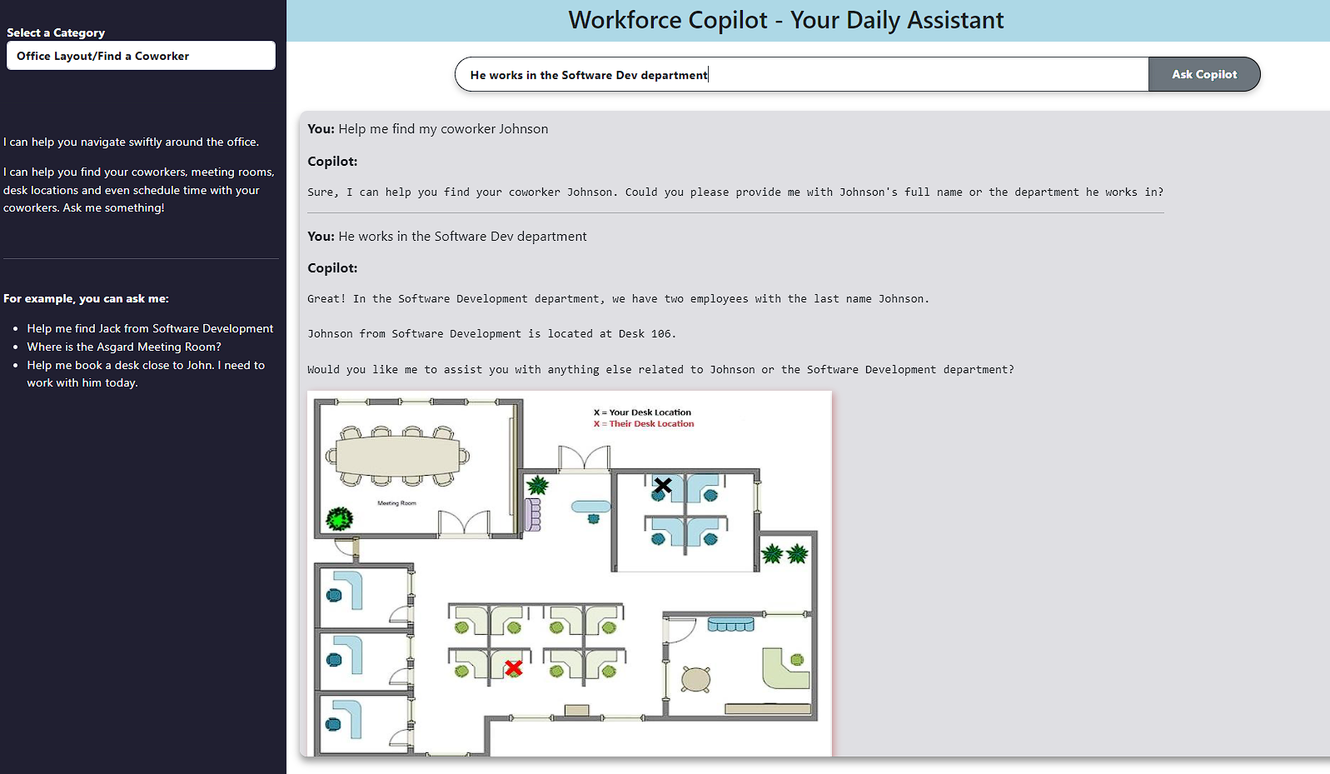




Introducing R.O.B – Employees’ Resourceful Office Buddy for everyday assistance
Employee
Has queries about the workplace
Helps find where people are located
Ask the Workplace Copilot Assistant
Assists in Performing Tasks & Provides Insights
Provides office map of where employee desks/meeting rooms are to ensure easy navigation
Redirects to Tech/Customer Support If Requested
Note: Video demonstration available in the Appendix Section

Slide 19



Tailored recommendations can potentially save productive hours and boost employee satisfaction
~84%
33
1.5 Pts
Office Cohort (Time Lost – Layout)
Employees In This Group Facing Issue
Productive Hrs Increased
Potential Increase in Satisfaction
~78%
192
1.4 Pts
1.6 Pts
Overall Increase in Potential Satisfaction
Hybrid Force (Time Lost – Visitors)
Employees In This Group Facing Issue
Productive Hrs Increased
Potential Increase in Satisfaction
~76%
193
1.8 Pts
Home Anchors (Time Lost – Noise)
Employees In This Group Facing Issue
Productive Hrs Increased
Potential Increase in Satisfaction
~418 Hours
Overall Increase in Potential Productive Hrs. Per Week
Note: Assuming Implementation for a Medium Size Firm (500 Employee) | Assuming 60% Effectiveness of the proposed solutions | Satisfaction Scale: Very Unsatisfied (0) – (5) Very Satisfied

Slide 20
Analyze tradeoff between “Estimated Impact” & “Implementation Effort” to prioritize proposed solutions
Estimated Immediate Impact
Quick Wins Noise Canceling Headphones Merit Spotlight Programs Cubicles & Focus Rooms | Major Projects Strategic Workplace Design Workforce Copilot
Medium Term Initiatives Mentorship/Learning Initiatives | Long Term Strategies Periodic Employee Pulse Check & Feedback Implementation
Implementation Effort
Phase 1
Quick Wins
Phase 2
Medium Term Initiatives
Phase 3
Major Projects
Phase 4
Long Term Strategies

Slide 21
Thank You! Questions?

Slide 22
Appendix

Slide 23



Problem Statement - Shifting of Working Patterns
?
+500%
50%
1,384
WFH increased from 5% to 30% since 2019
Office occupancy at half of
pre-pandemic level
1,384 survey respondents with 183 questions from 5 organizations
Productivity?
Preference?
How can an organization best support its employees?

Slide 24





Objective - What are we trying to solve?
42% Feel More Productive at Home*
43% Feel More Productive at Office*
Recommendations and Deployment
Rule-Based Segmentation
Modeling for More Insights
Identifying Productivity and Preference Factors
Understand Employee’s Behavior
*Result of Forbes research through surveys. People are split about their preferences. https://www.forbes.com/sites/tracybrower/2023/08/06/the-productivity-problem-with-remote-work.

Slide 25


Ability to do focused work drives work location preferences
Preferred Environment for Focused Work
80%
80%
62%
Employees who like to switch from focused work to collaborative work/social events intermittently prefer open workspaces
WFH Preference Rate
60%
50%
40%
35%
20%
0%
Home
Temporary Workspace
Office Workstation
Enclosed Office Space
Notes:
Change to percentage

Slide 26
Satisfaction from collaborating in the office could potentially highlight employees’ workplace preference
Office goers are satisfied with the office collaboration setup
Office Collab Satisfaction ¹
Employees who prefer Working from Home are less satisfied with Office Collab Setup
0-20%
20-40%
40-60%
60-80%
80-100%
WFH Preference Rate
1. Average Satisfaction for Inperson and Virtual Collaboration using Office Space and Tech; 0 = Unsatisfied, 5 = Satisfied

Slide 27

“Work Location Preference Composite Score” can be utilized for gauging employees’ workplace preference
Ability to
be Individually Productive
Ability to
Collaborate Effectively
-21%
Work Location
Preference Composite Score ¹
Strongly
Influence
Location Employee Prefer to Work in
0-20%
20-40%
40-60%
60-80%
80-100%
WFH Preference Rate
1. Calculated as an Average of Perceived Optimal Work Environment for supporting all types of work (Ability to focus, do concentrative work, collaborate, access colleagues, interact with managers, innovate etc.) ; 0 = Home Preferred, 5 = Office Preferred. Used as a Proxy to handle missing values in WFH Pref Rate Metric
Notes:
Change to height difference

Slide 28
Modeling – Decision Tree Model Metrics
Metric/Parameter | Value
Max Depth | 10
Splitting Crierion | Mean Squared Error
Mean Squared Error (Test) | 1.35
Mean Absolute Error (Test) | 0.87
Target Variable | Work Location Preference Composite Score

Slide 29
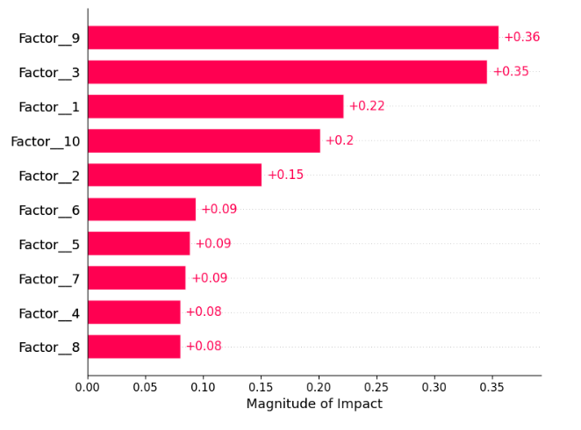
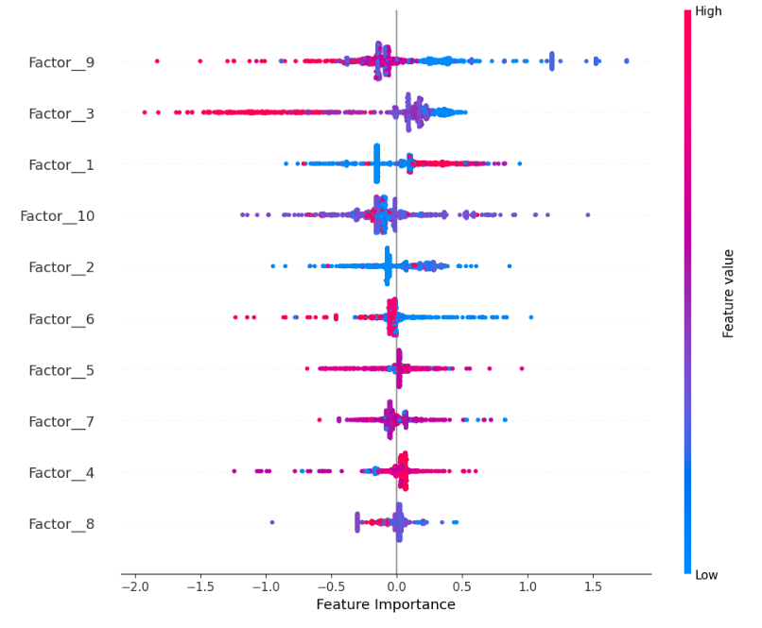
Modeling - Shapley Values Feature Importance (Target = Work Location Preference Composite Score)
Shapley Values for Each Factor
Shapley - Direction of Impact

Slide 30
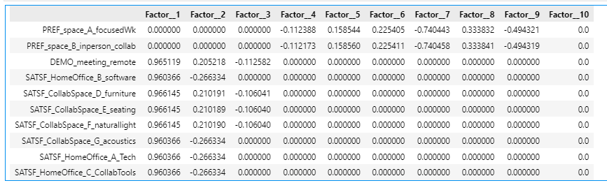
Modeling - Factor Loadings (Factor 9 Major Contributors)

Slide 31
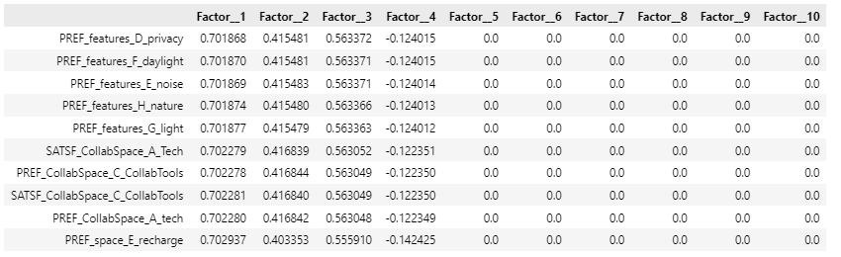
Modeling - Factor Loadings (Factor 3 Major Contributors)

Slide 32
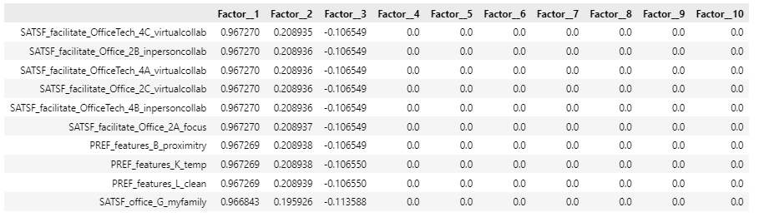
Modeling - Factor Loadings (Factor 1 Major Contributors)

Slide 33
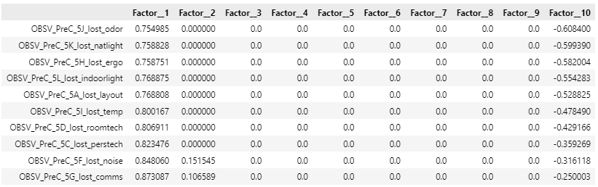
Modeling - Factor Loadings (Factor 10 Major Contributors)

Slide 34
Important Variables Used in Analysis - Dictionary
Group Var | Individual Vars
Perceived Productivity Quotient | AVG(PostC_impact_shift_A_focus, PostC_impact_shift_E_innovate)
Perceived Collaborative Quotient | AVG([PostC impact shift F colleagueaccess] + [PostC impact shift G teammeetings] + [PostC impact shift H social] + [PostC impact shift I managersconnect] + [PostC impact shift J client])
Distraction Overall | SUM(OBSV_PreC_5F_lost_noise, OBSV_PreC_5A_lost_layout, OBSV_PreC_5E_lost_visitors)
Tech Quotient | PREF_CollabSpace_A_tech, PREF_CollabSpace_B_software, PREF_CollabSpace_C_CollabTools
Collaboration Satisfaction Used in Clustering | AVG([SATSF facilitate Office 2B inpersoncollab] + [SATSF facilitate Office 2A focus] + [SATSF facilitate Office 2C virtualcollab])
Culture Quotient | AVG(DECSN_factors_H_purpose, DECSN_factors_K_socialevents, DECSN_factors_L_community, DECSN_factors_Q_leadership)
Office Collaboration Satisfaction | SATSF_facilitate_Office_2B_inpersoncollab, SATSF_facilitate_Office_2C_virtualcollab, SATSF_facilitate_OfficeTech_4B_inpersoncollab
Composite Score | PostC_impact_shift_A_focus, PostC_impact_shift_B_productive, PostC_impact_shift_C_collab, PostC_impact_shift_D_videoconf, PostC_impact_shift_E_innovate, PostC_impact_shift_F_colleagueaccess, PostC_impact_shift_G_teammeetings, PostC_impact_shift_H_social, PostC_impact_shift_I_managersconnect, PostC_impact_shift_J_client, PostC_impact_shift_K_enjoy

Slide 35
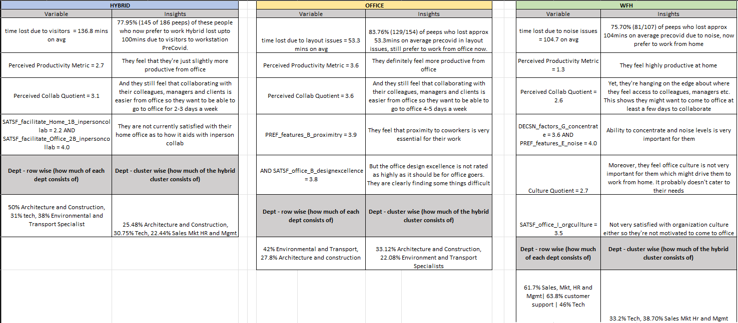
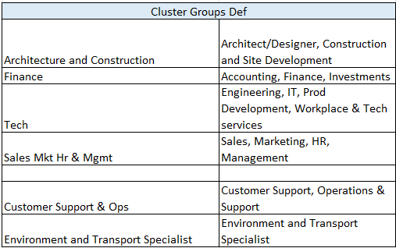
Segments – Detailed Summary

Slide 36
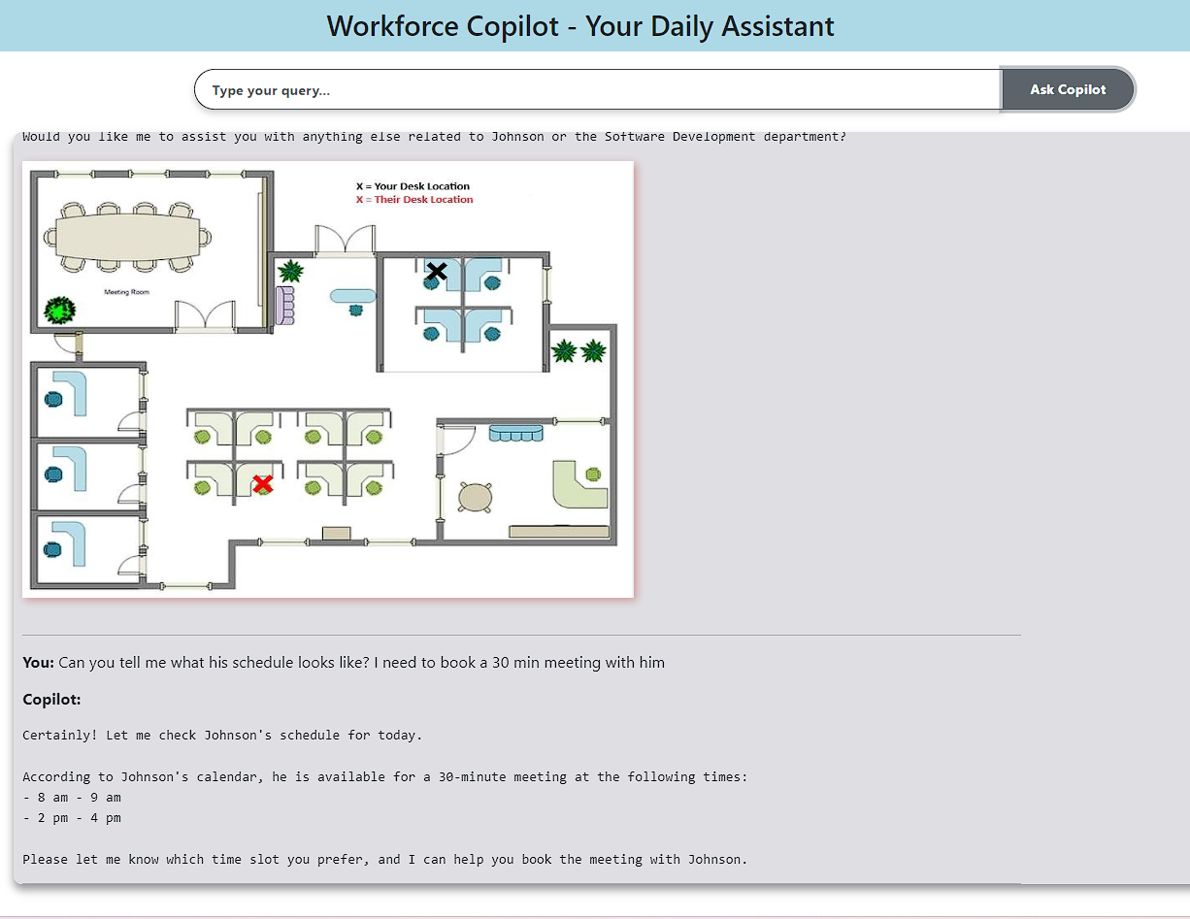
Introducing R.O.B – Employees’ Resourceful Office Buddy for everyday assistance
Employee
Has queries about the workplace
Ask the Workplace Copilot Assistant
Assists in Performing Tasks & Provides Insights
Fosters easy collaboration with coworkers by being respectful of their schedules
Redirects to Tech/Customer Support If Requested
Note: Video demonstration available in the Appendix Section

Slide 37
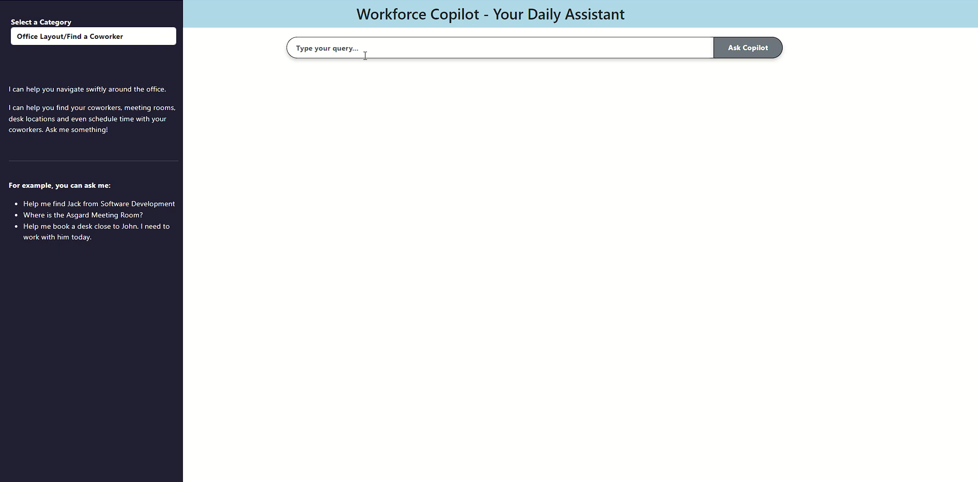
Copilot Demo – Video Walkthrough

Slide 38
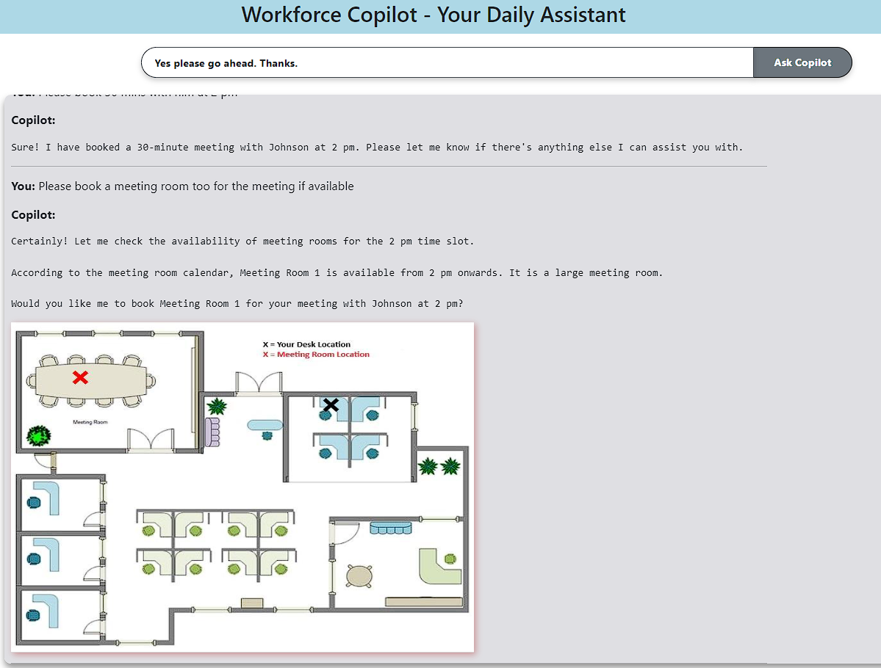
Copilot Demo – Help in finding meeting rooms
Employee
Has queries about the workplace
Ask the Workplace Copilot Assistant
Assists in Performing Tasks & Provides Insights
Provides office map of where meetings are setup to ensure easy navigation
Redirects to Tech/Customer Support If Requested
Video demonstration available in the Appendix Section

Slide 39
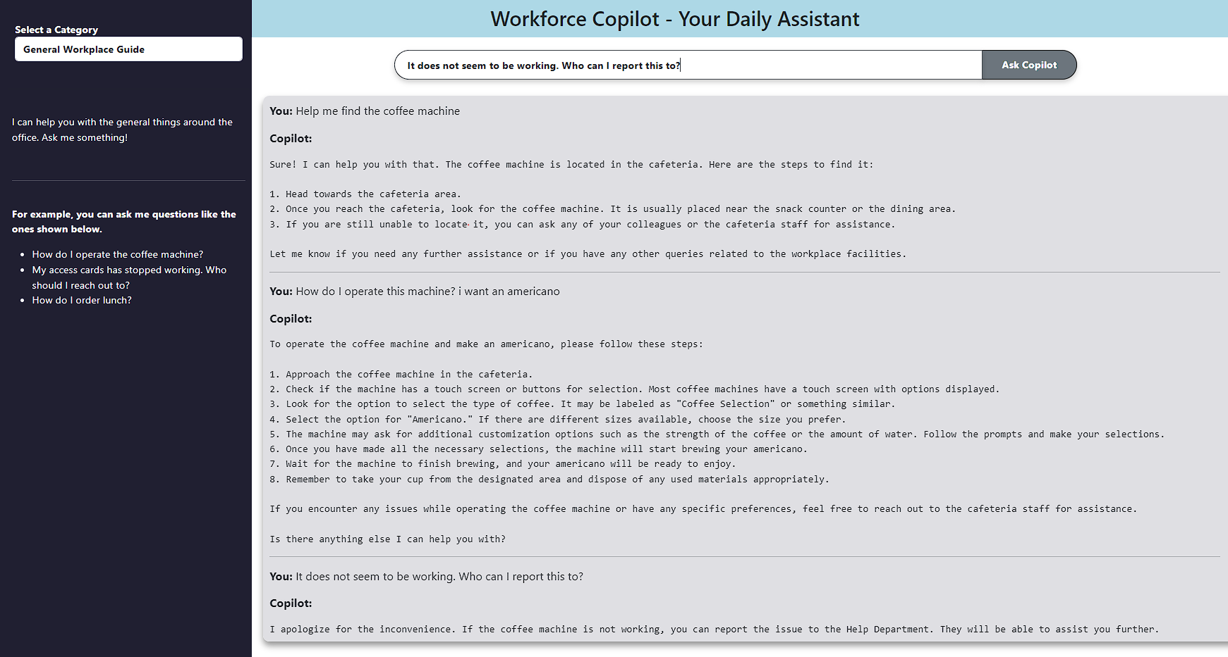
Copilot Demo – General Help Around The Office

Slide 40
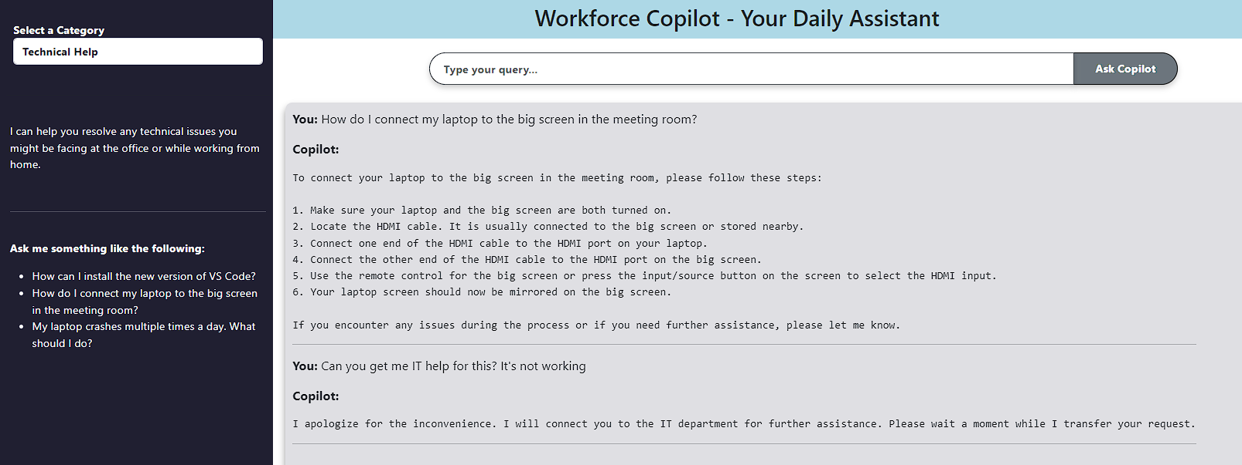
Copilot Demo – IT Support

Slide 41
Recommendation Impact - Potential Increase in Productive Work Hours Calculations
 | Office = layout problems | Hybrid = unwanted visitor problems | WFH = noise problem
% Of People Out Of Entire Dataset [1] | 15% | 36% | 49%
% Of Employees who had issues in this cluster [2] | 83.76% | 78.00% | 75.70%
Assumed - Mid Size Organization with 500 employees [3] | 500 | 500 | 500
% of people in assumed organization that fall in this cluster [1]*[3] ---- [4] | 75 | 180 | 245
% of people with layout problem in assumed organization [2]*[4] --- [5] | 62.82 | 140.4 | 185.465
Mins lost Avg In a Week due to distraction [6] | 53.3 | 136.8 | 104
Mins lost total in assumed organization [5]*[6] --- [7] | 3348.306 | 19206.72 | 19288.36
Hours lost total per week [7]/60 --- [8] | 55.81 | 320.11 | 321.47
Assumed decrease in productive hours lost by implementing Workforce Copilot [9] | 0.6 | 0.6 | 0.6
Time Saved in Hrs Per Week [8]*[9] --- [10] | 33.48 | 192.07 | 192.88
Total Hours Saved In Organization SUM[10]-- [11] | 418.43 Hrs
Notes:
Forbes suggests WFH becoming the norm, focusing on minimizing distractions.
Techniques emphasized:
Controlling workflow.
Reducing multitasking.
Eliminating distractions.

Slide 42
Recommendation Impact - Potential Increase in Satisfaction Calculation
 |  | Hybrid | Office | WFH
Group-1: Collaboration Satisfaction* > Avg(Collaboration Satisfaction) --- [1] | Avg. Collab_Satisfaction Rating --- 1.i | 4.3 | 4.3 | 4.3
 | Count of Collab_Satsf_Rule Rating --- 1.ii | 272 | 123 | 420
Group-2: Collaboration Satisfaction* < Avg(Collaboration Satisfaction) ---[2] | Avg. Collab_Satisfaction Rating -- 2.i | 2.9 | 2.8 | 2.5
 | Count of Collab_Satsf_Rule Rating --- 2.ii | 89 | 31 | 71
Employee Base Who have below avg satsf SUM(2.ii)/(Sum(2.ii) + Sum(1.ii))*100 --- [3] |  | 19%
Potential Bump In Satisfaction Points by Implementing Recommendations in this cluster [1.i] - [2.i] --- [4] |  | 1.4 | 1.5 | 1.8
Potential Bump In Satisfaction % by Implementing Recommendations [4]/[2.i] --- [5] |  | 48% | 54% | 72%
Potential Bump In Organization Satisfaction Points by Implementing Recommendations Overall Avg[4] --- [6] |  | 1.57
Potential Bump In Organization Satisfaction % by Implementing Recommendations Overall Avg[5]--- [7] |  | 57.95%
*Collaboration Satisfaction = ([SATSF facilitate Office 2B inpersoncollab] + [SATSF facilitate Office 2A focus] + [SATSF facilitate Office 2C virtualcollab])/3
Notes:
Forbes suggests WFH becoming the norm, focusing on minimizing distractions.
Techniques emphasized:
Controlling workflow.
Reducing multitasking.
Eliminating distractions.

Slide 43
Miscellaneous - Office Layout Issues +Visitor Disturb+ Ease Of Collaboration
Distraction Metrics | Employees with Sats < 3 (avg time lost) | Employees with Sats >= 3 | Percent difference
OBSV_PreC_5A_lost_layout | 53 min | 41 min | -24%
OBSV_PreC_5B_lost_looking | 81 min | 42 min | -49%
OBSV_PreC_5D_lost_roomtech | 33 min | 27 min | -18%
OBSV_PreC_5E_lost_visitors | 203 min | 109 min | -46%
Total | 307 min | 190 min | -38%

Slide 44
Miscellaneous - Noise And Focus
Moving from Dissatisfied to Satisfied
Expected Distraction Reduction
Distraction Metrics | Employees with Sats < 2.5 (avg time lost) | Employees with Sats >= 2.5 | Percent difference
OBSV_PreC_5F_lost_noise | 142 min | 49 min | -65%

Slide 45
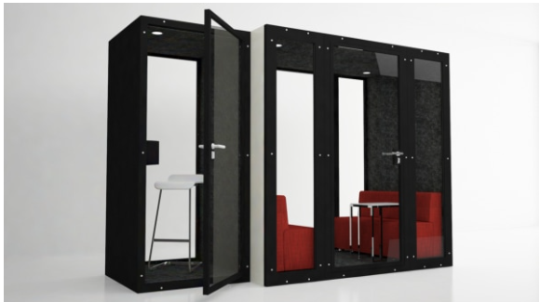
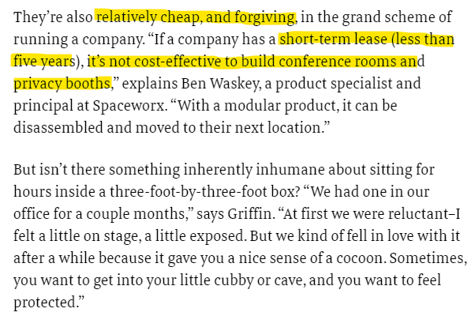
Recommendation Prioritization – Cubicles and Focus Rooms
https://www.fastcompany.com/90305213/the-hip-new-open-plan-office-trend-cubicles

